Slide 1
Mobile Application Development
Lecture 5

Slide 2
Lifecycle Methods in Angular
What are lifecycle methods? every component has a life-cycle, a number of different stages it goes through.
Lifecycle methods are functions that run during various times for a component.
There are 8 different stages in the component lifecycle in Angular. Every stage is called as lifecycle hook event.

Slide 3
Lifecycle Methods in Angular
We can use these hook events in different phases of our application to obtain control of the component.
Angular executes its lifecycle hook methods in a specific order.
Every framework (React.js , Vue.js) have lifecycle methods. Ionic also has few mobile related lifecycle methods.

Slide 4
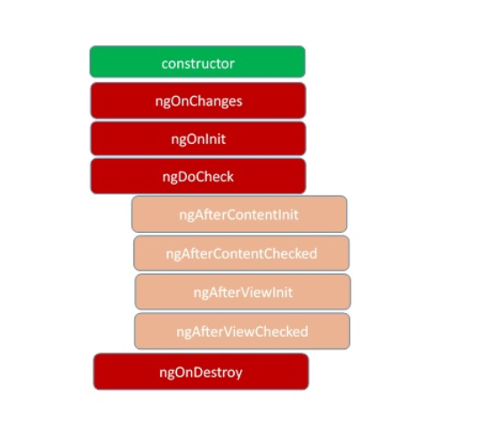
Lifecycle Methods in Angular
Since a component is a TypeScript class, every component must have a constructor method. The constructor of the component class executes, first, before the execution of any other lifecycle hook events.
After executing the constructor, Angular executes its lifecycle hook methods in a specific order.

Slide 5
Lifecycle Methods in Angular
Important lifecycle methods that you will use regularly and should know are ngOnInit, ngOnChanges, ngOnDestroy and ngOnViewInit. Others are not that important but you need to know they exist.
ngOnChanges() - This event executes every time when a value of an @Input() control within the component has been changed.
ngOnInit() - This event initializes after Angular first displays the data-bound properties or when the component has been initialized.

Slide 6
Lifecycle Methods in Angular
ngAfterViewInit() - This method is initialized after Angular initializes the component’s view and child views.
ngOnDestroy() - This event initializes after Angular first displays the data-bound properties or when the component has been initialized. This method is very useful for unsubscribing from the observables and detaching the event handlers to avoid memory leaks.
In React.js, the equivalent to ngOnInit() is componentDidMount(), in Vue.js, it is Created()

Slide 7
“People see in you what you see in yourself.”

Slide 8
Constructor vs ngOnInit
If we need to inject any dependencies (services) into the component, then the constructor is the best place to inject those dependencies. So you should use constructor() to setup Dependency Injection and not much else.
Dependency Injection (DI) is a software design pattern that deals with how components get hold of their dependencies. (we will get back to this topic in lecture 11 when we discuss Services).

Slide 9
Constructor vs ngOnInit
OK, first of all ngOnInit is part of Angular lifecycle, while constructor is part of ES6 JavaScript class / TypeScript.
The Javascript engine is what handles the constructor, not Angular. Constructors are not related to Angular, they are a TypeScript feature / ES6 JavaScript class.
Do any sort of initialization in ngOnInit and not in constructor. Why? your native elements will not be available during the constructor phase. Component input initial values aren't available in constructor, but they are available in ngOnInit.

Slide 10
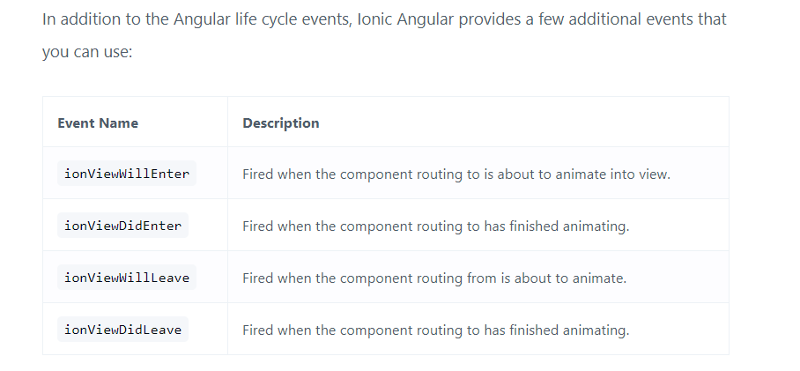
Ionic Page lifecycle
https://ionicframework.com/docs/angular/lifecycle

Slide 11
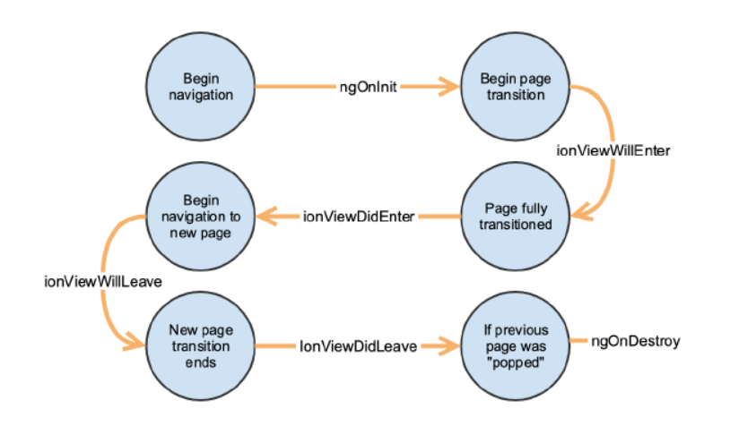
Ionic Page lifecycle

Slide 12
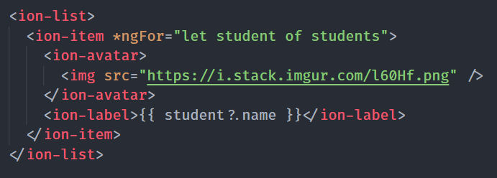
*ngFor usage in Ionic
*ngFor is a builtin directive that you can use in your Angular templates to iterate through lists and arrays of data in order to display it.

Slide 13
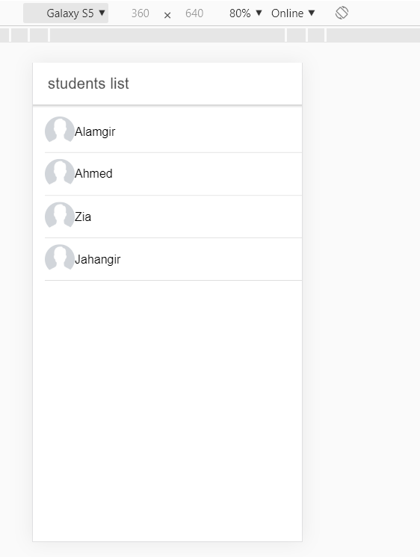
*ngFor usage in Ionic
Result of *ngFor

Slide 14
*ngIf usage in Ionic
*ngIf removed or adds an element to View depending on the condition.

Slide 15
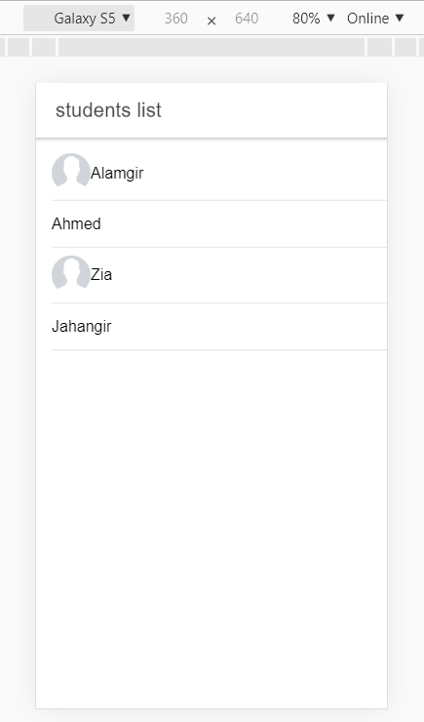
*ngIf usage in Ionic
*ngIf result. No Avatar for Ahmed and Zia as they are ‘absent’.

